Slide 1
Lecture 2
Intelligent Agents
Russell and Norvig
Syllabus
Special thanks to Dr. Yaohang Li for contributing the slides

Slide 2
Review of Intelligent Agents
Motivation
Objectives
Introduction
Agents and Environments
Rationality
Agent Structure
Agent Types
  Simple reflex agent
  Model-based reflex agent
  Goal-based agent
  Utility-based agent
  Learning agent

Slide 3
Introduction to Intelligent Agents
Motivation
  Agents are used to provide a consistent viewpoint on various topics in AI
  Agents require essential skills to perform tasks that require intelligence
  Intelligent agents use methods and techniques from the field of AI
What is an agent?
  In general, an entity that interacts with its environment
    Perception through sensors
    Actions through effectors or actuators
Agent and its environment
  An agent perceives its environment through sensors
    The complete set of inputs at a given time is called a percept
    The current percept, or a sequence of percepts may influence the actions of an agent
  It can change the environment through actuators
    An operation involving an actuator is called an action
    Actions can be grouped into action sequences

Slide 4
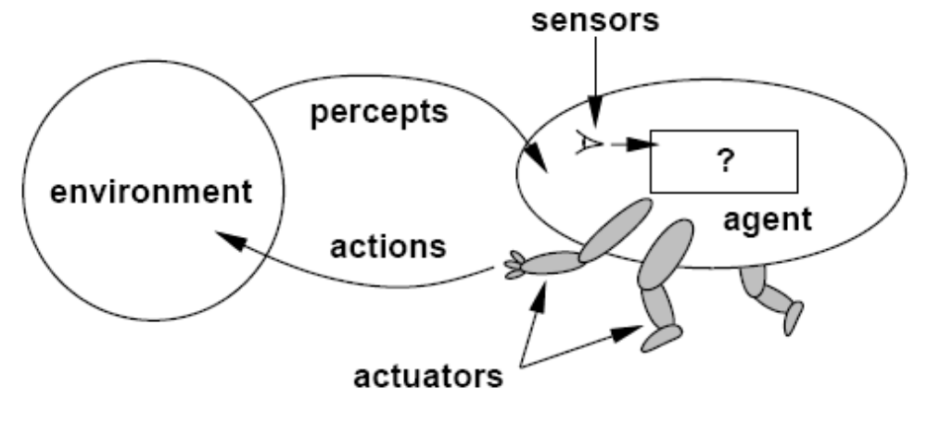
Intelligent Agents

Slide 5
Example of Agents
  Human agent
    Eyes, ears, skin, taste buds, etc. for sensors
    Hands, fingers, legs, mouth, etc. for actuators
      Powered by muscles
  Robot
    Camera, infrared, bumper, etc. for sensors
    Grippers, wheels, lights, speakers, etc. for actuators
      Often powered by motors
  Software agent
    Functions as sensors
      Information provided as input to functions in the form of encoded bit strings or symbols
    Functions as actuators
      Results deliver the output

Slide 6
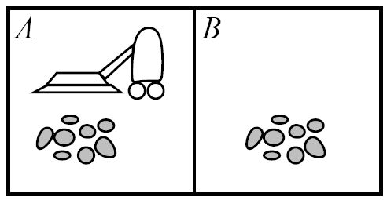
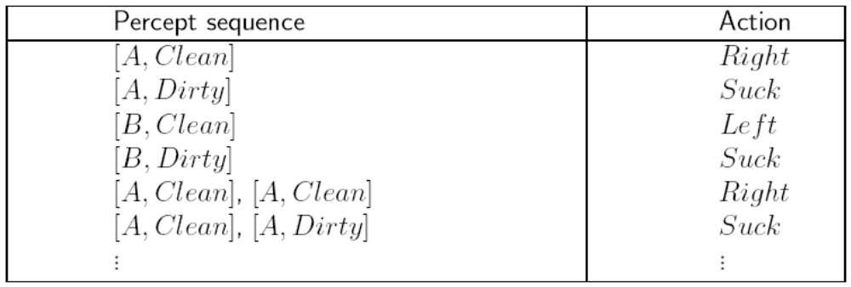
Vacuum-Cleaner World

Slide 7
Agents and Their Environment
A rational agent does “the right thing”
  The action that leads to the best outcome under the given circumstances
An agent function maps percept sequences to actions
  Abstract mathematical description
An agent program is a concrete implementation of the respective function
  It runs on a specific agent architecture (“platform”)
Problems:
  What is “ the right thing”
  How do you measure the “best outcome”

Slide 8
The Concept of Rationality
Concept of Rationality
  Rational ≠ omniscient (knowing everything)
    Percepts may not supply all relevant information
  Rational ≠ clairvoyant(beyond normal sensory contact)
    Action outcomes may not be as expected
  Rational ≠ successful
  Rationality vs Perfection
    Rationality maximizes expected performance
    Perfection maximizes actual performance
  Rational → exploration, learning, autonomy

Slide 9
Performance Measure
Performance of Agents
  Criteria for measuring the outcome and the expenses of the agent
    Often subjective, but should be objective
    Task dependent
    Time may be important
Performance measure example
  Vacuum agent
    Performance Measure: number of tiles cleaned during a certain period
      Based on the agent’s report, or validated by an objective authority
      Doesn’t consider expenses of the agent, side effects
        Energy, noise, loss of useful objects, damaged furniture, scratched floor
      Might lead to unwanted activities
        Agent re-cleans clean tiles, covers only part of the room, drops dirt on tiles to have more tiles to clean, etc.
    Alternative Performance Measure:
      One point per square cleaned up in time T?
      One point per clean square per time step, minus one per move
      Penalize for > k dirty squares?

Slide 10
Rational Agents
Rationality: selects the action that is expected to maximize its performance
  Based on a performance measure
  Depends on the percept sequence, background knowledge, and feasible actions
Performance measure for the successful completion of a task
  Complete perceptual history (percept sequence)
  Background knowledge
    Especially about the environment
      Dimensions, structure, basic “laws”
    Task, user, other agents
  Feasible actions
    Capabilities of the agent
Definition of a Rational Agent
  For each possible percept sequence, a rational agent should select an action that is expected to maximize its performance measure, given the evidence provided by the percept sequence and whatever built-in knowledge the agent has.

Slide 11
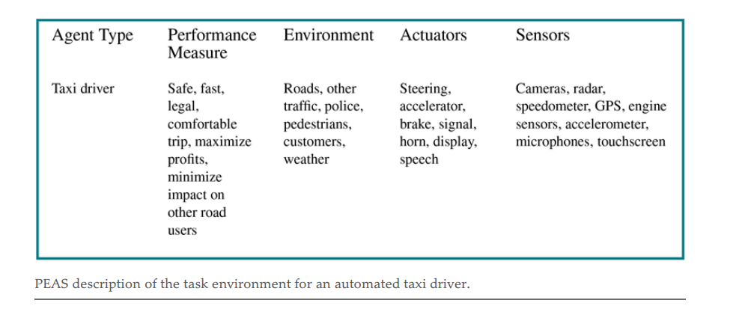
The Nature of Environments
Environment
  Determine to a large degree the interaction between the “outside world” and the agent
    The “outside world” is not necessarily the “real world” as we perceive it
  In many cases, environments are implemented within computers
    They may or may not have a close correspondence to the “real world”
    No changes while the agent is “thinking”.
    Task environment :The nature of the task environment directly affects the appropriate design for the agent program.
    Specifying the task environment :PEAS description :
    Performance, Environment, Actuators, Sensors description

Slide 12
Specifying the Task Environment (I)
PEAS Description
Performance Measures
Used to evaluate how well an agent solves the task at hand
Environment
Surroundings beyond the control of the agent
Actuators
Determine the actions the agent can perform
Sensors
Provide information about the current state of the environment

Slide 13
VacBot PEAS Description
Performance Measures
Environment
Actuators
Sensors
Cleanliness of the floor
Time needed
Energy consumed
Grid of tiles
Dirt on tiles
Possibly obstacles, varying amounts of dirt
Movement (wheels, tracks, legs, ...)
Dirt removal (nozzle, gripper, ...)
Position (tile ID reader, camera, GPS, ...)
Dirtiness (camera, sniffer, touch, ...)
Possibly movement (camera, wheel movement)

Slide 14
SearchBot PEAS Description
Performance Measures
Environment
Actuators
Sensors
Number of “hits” (relevant retrieved items)
Recall (hits / all relevant items)
Precision (relevant items/retrieved items)
Quality of hits
Document repository (data base, files, WWW, ...)
Computer system (hardware, OS, software, ...)
Network (protocol, interconnection, ...)
Query functions
Retrieval functions
Display functions
Input parameters

Slide 15
Chess Player PEAS Description
Performance Measures
Environment
Actuators
Sensors
Winning the game
Time spent in the game
Chessboard
Positions of every piece
Move a piece
Input from the keyboard

Slide 16
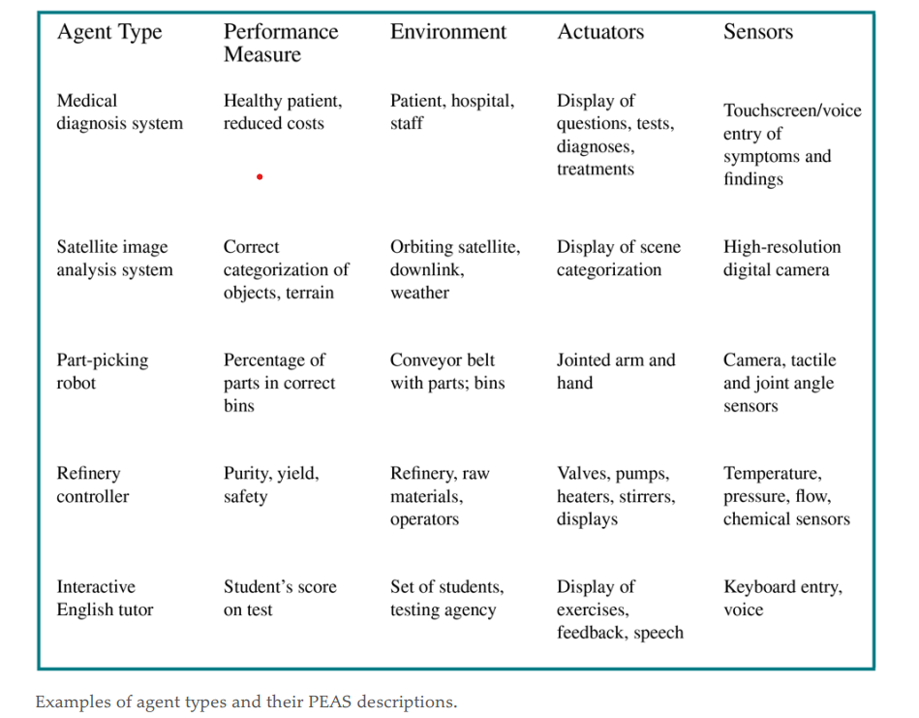
The Nature of Environments

Slide 17
Specifying the Environment (II)
PAGE Description:
Used for high-level characterization of agents
Percepts
Information acquired through the agent’s sensory system
Actions
Operations performed by the agent on the environment through its actuators
Goals
Desired outcome of the task with a measurable performance
Environment
Surroundings beyond the control of the agent

Slide 18
VacBot PAGE Description
Tile properties like clean/dirty, empty/occupied
movement and orientation
Percepts
Actions
Goals
Environment
Pick up dirt, move
Keep the floor clean
House, Apartment

Slide 19
StudentBot PAGE Description
Images (text, pictures, instructor, classmates)
Sound (language)
Percepts
Actions
Goals
Environment
Comments, questions, gestures
Note-taking (?)
Mastery of the material
Performance measure: grade
Classroom

Slide 20
Environment Properties
  Fully observable vs. partially observable
    Sensors capture all relevant information from the environment
  Deterministic vs. stochastic (non-deterministic)
    Changes in the environment are predictable
  Episodic vs. sequential (non-episodic)
    Independent perceiving-acting episodes
  Static vs. dynamic
    No changes while the agent is “thinking”
  Discrete vs. continuous
    Limited number of distinct percepts/actions
  Single vs. multiple agents
    Interaction and collaboration among agents
    Competitive, cooperative

Slide 21
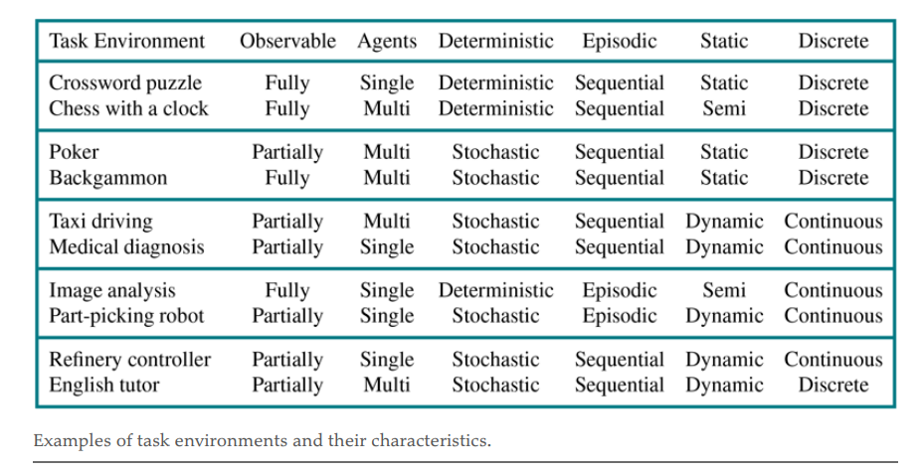
Environment Properties

Slide 22
Structure Of Agents
agent = architecture + program .
The job of AI is to design an agent program that implements the agent function—the mapping from percepts to actions.
Example:
If the program is going to recommend actions like Walk, the architecture had better have legs.

Slide 23
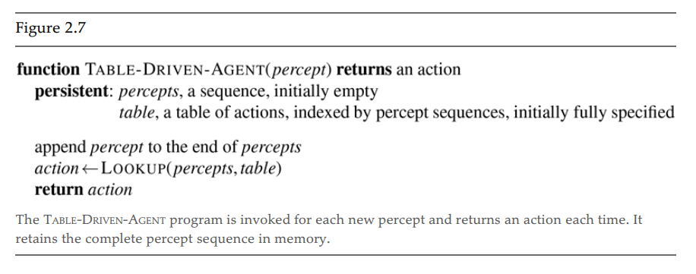
Agent Programs
Difference between the agent program, which takes the current percept as input, and the agent function, which may depend on the entire percept history. If the agent’s actions need to depend on the entire percept sequence, the agent will have to remember the percepts.
For example, Figure 2.7 shows a rather trivial agent program that keeps track of the percept sequence and then uses it to index into a table of actions to decide what to do.
The table—an example of which is given for the vacuum world in Figure 2.3 — represents explicitly the agent function that the agent program embodies

Slide 24
Agent Program Types
Classification of Agent Programs
  Different ways of achieving the mapping from percepts to actions
  Different levels of complexity
Agent Program Types
  Simple reflex agents
  Agents that keep track of the world
  Goal-based agents
  Utility-based agents
  Learning agents

Slide 25
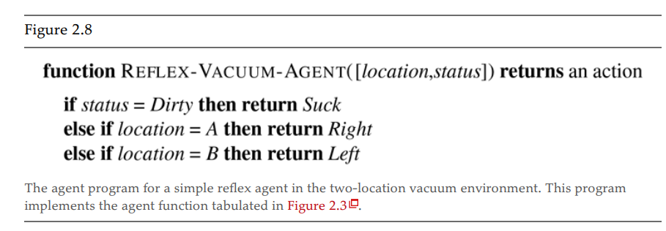
Simple Reflex Agents
Simple Reflex Agents
These agents select actions based on the current percept, ignoring the rest of the percept history.
For example, the vacuum agent whose agent function is tabulated in Figure 2.3 is a simple reflex agent, because its decision is based only on the current location and on whether that location contains dirt.
Notes:
A simple reflex agent takes an action based on only the current environmental situation; it maps the current percept into proper action ignoring the history of percepts. The mapping process could be simply a table-based or by any rule-based matching algorithm. An example of this class is a robotic vacuum cleaner that deliberate in an infinite loop, each percept contains a state of a current location [clean] or [dirty] and, accordingly, it decides whether to [suck] or [continue-moving].

Slide 26
condition–action rule
Imagine yourself as the driver of the automated taxi. If the car in front brakes and its brake lights come on, then you should notice this and initiate braking.
if car-in-front-is-braking then initiate-braking.

Slide 27
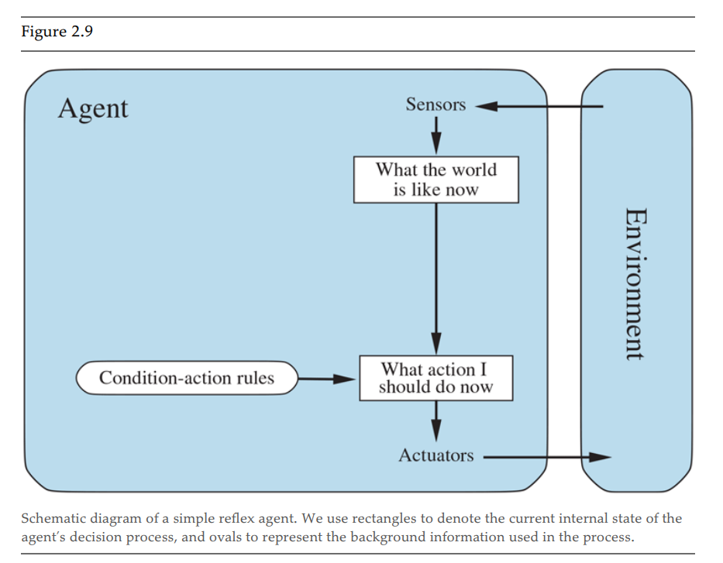
Simple Reflex Agent

Slide 28
Model-based Reflex Agents
  The agent should maintain some sort of internal state that depends on the percept history and thereby reflects at least some of the unobserved aspects of the current state.
  Updating this internal state information as time goes by requires two kinds of knowledge to be encoded in the agent program in some form.
  This knowledge about “how the world works”—whether implemented in simple Boolean circuits or in complete scientific theories—is called a transition model of the world.
  we need some information about how the state of the world is reflected in the agent’s percepts. This kind of knowledge is called a sensor model.
  Together, the transition model and sensor model allow an agent to keep track of the state of the world—to the extent possible given the limitations of the agent’s sensors. An agent that uses such models is called a model-based agent.
Notes:
A model-based reflex agent needs memory for storing the percept history; it uses the percept history to help to reveal the current unobservable aspects of the environment. An example of this IA class is the self-steering mobile vision, where it's necessary to check the percept history to fully understand how the world is evolving.

Slide 29
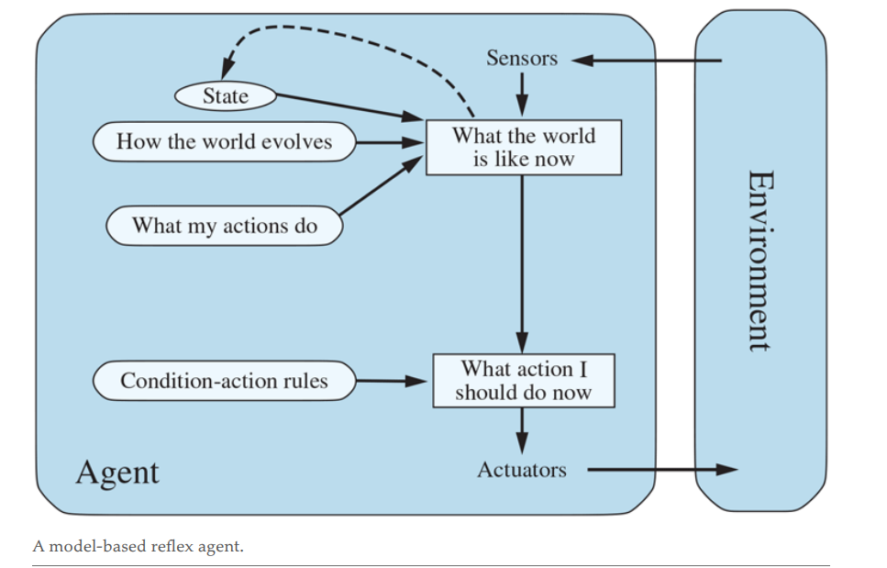
Model-based Reflex Agents

Slide 30
Goal-based Agent
The agent tries to reach a desirable state, the goal
  May be provided from the outside (user, designer, environment), or inherent to the agent itself
Results of possible actions are considered with respect to the goal
  Easy when the results can be related to the goal after each action
  In general, it can be difficult to attribute goal satisfaction results to individual actions
  May require consideration of the future
    What-if scenarios
    Search, reasoning or planning
Very flexible, but not very efficient
Notes:
A goal-based reflex agent has a goal and has a strategy to reach that goal. All actions are taken to reach this goal. More precisely, from a set of possible actions, it selects the one that improves the progress towards the goal (not necessarily the best one). An example of this IA class is any searching robot that has an initial location and wants to reach a destination.

Slide 31
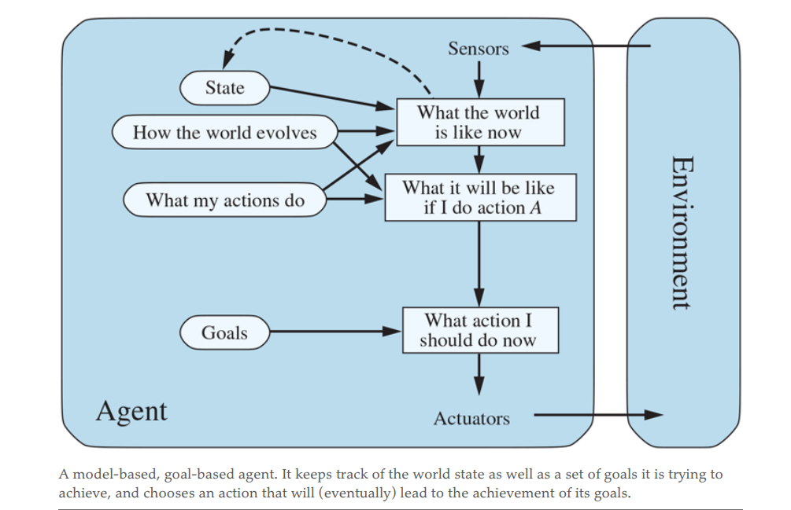
Goal-based Agent

Slide 32
A Utility-based Agent
More sophisticated distinction between different world states
  A utility function maps states onto a real number
    May be interpreted as “degree of happiness”
  Permits rational actions for more complex tasks
    Resolution of conflicts between goals (tradeoff)
    Multiple goals (likelihood of success, importance)
    A utility function is necessary for rational behavior, but sometimes it is not made explicit
Notes:
An utility-based reflex agent is like the goal-based agent but with a measure of "how much happy" an action would make it rather than the goal-based binary feedback ['happy', 'unhappy']. This kind of agents provide the best solution. An example is the route recommendation system which solves the 'best' route to reach a destination.

Slide 33
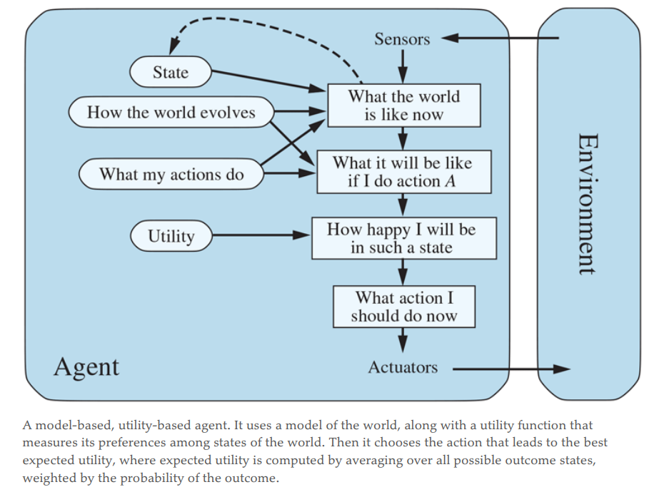
A Utility-based Agent

Slide 34
Learning Agent
Performance element
  Selects actions based on percepts, internal state, background knowledge
  Can be one of the previously described agents
Learning element
  Identifies improvements
Critic
  Provides feedback about the performance of the agent
  Can be external; sometimes part of the environment
Notes:
A learning agent is an agent capable of learning from experience. It has the capability of automatic information acquisition and integration into the system. Any agent designed and expected to be successful in an uncertain environment is considered to be learning agent.

Slide 35
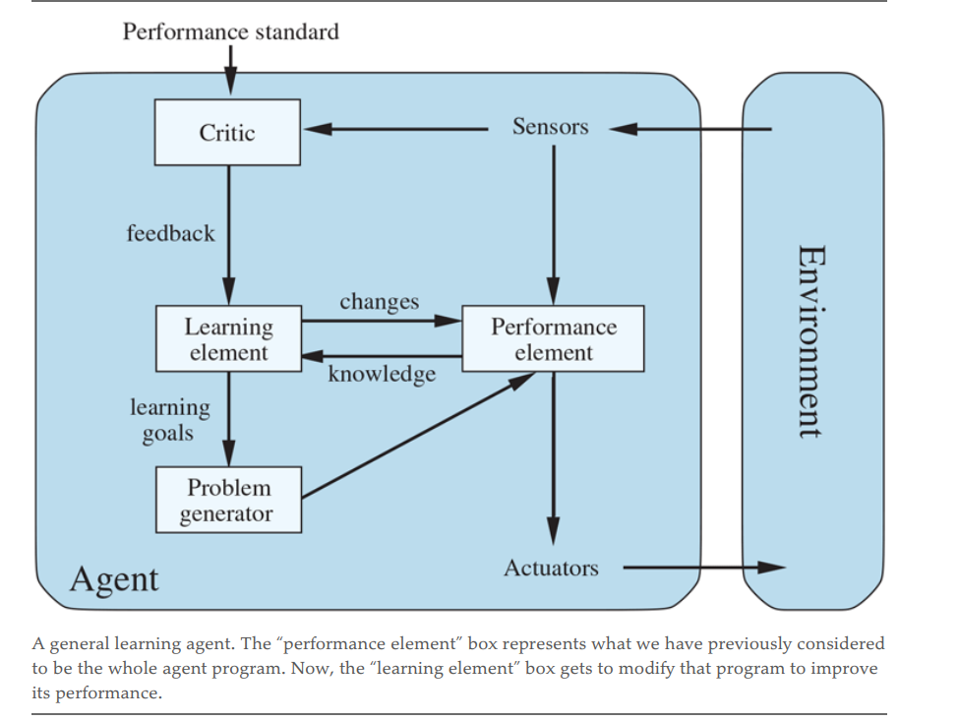
A Model of a Learning Agent

Slide 36
Summary
Agents perceive and act in an environment
  Definition of Percept
  Description of the environment (PEAS)
Ideal agents maximize their performance measure
  Rationality
  Performance Measure
  Rational Agent
Basic agent types
  Simple reflex
  Reflex with state
  Goal-based
  Utility-based
  Learning
Some environments may make life harder for agents
  Inaccessible, non-deterministic, non-episodic, dynamic, continuous

Slide 37
What I want you to do
Review Chapter 2
Review Class Notes

